Slide 1


You
cloning
project
Disclaimer
This project is solely intended for educational purposes and is created under fair use. Developed by Sayf Rourou

Slide 2
Table of contents
01
02
03
INTRODUCTION
DEMO
SCREENSHOTS
04
05
USED TECHNOLOGIES
FEATURES

Slide 3

01
INTRODUCTION

Slide 4

This YouTube cloning project Is about creating a webapp similar to YouTube, which can be used to watch “Videos” edited, uploaded and commented by registered users who can like, dislike and share their opinions on “Videos” and “Comments” belong to them or to other users.

Slide 5

02
DEMO

Slide 6

DEMO
This Website is hosted to show how the YouTube cloning project works. http://youtube-project.tk/

Slide 7

03
SCREENSHOTS

Slide 8
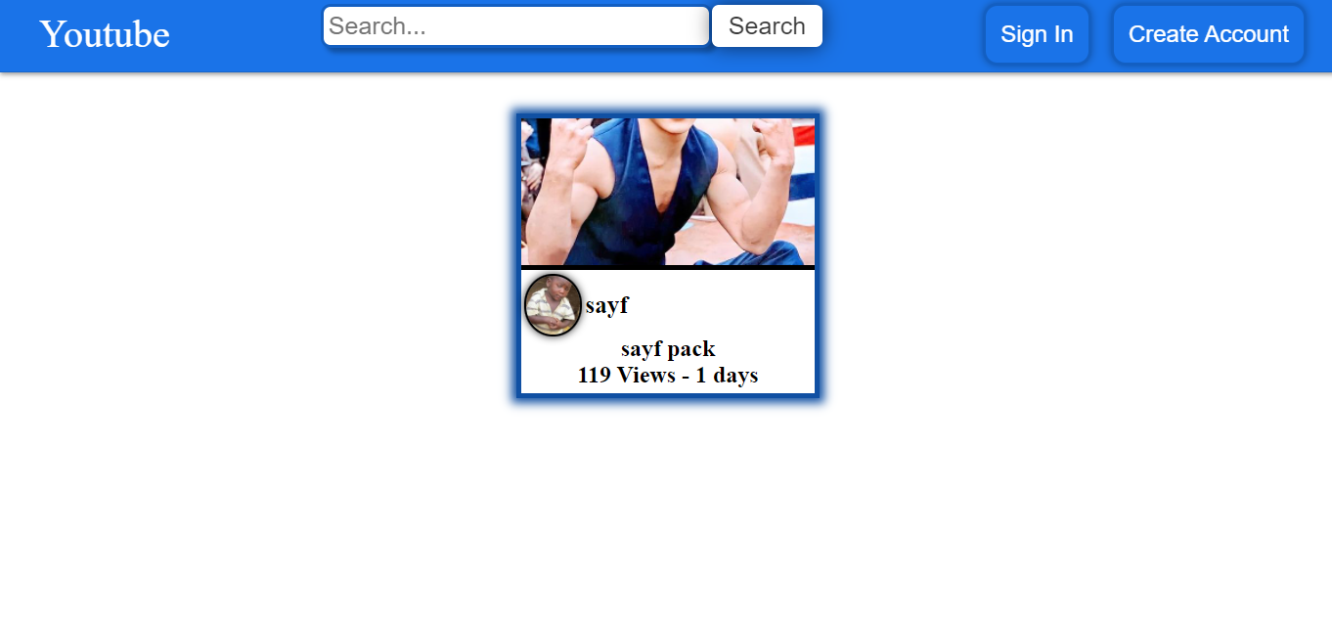
WELCOME TO HOME PAGE

Slide 9
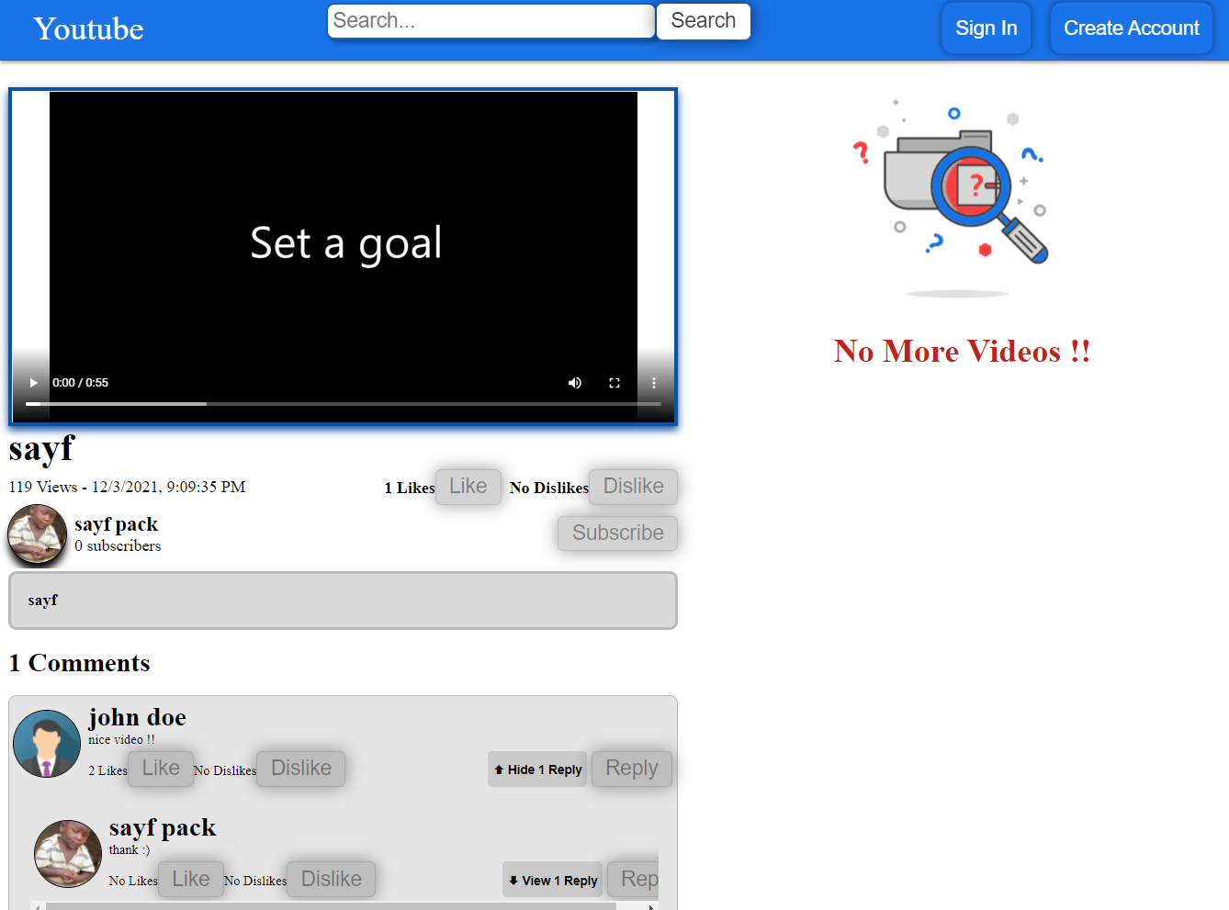
Watching a video

Slide 10
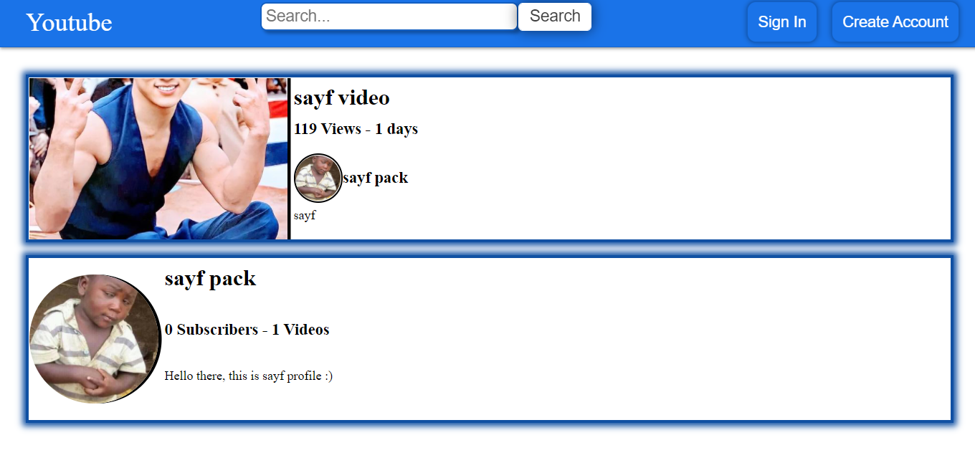
Searching for videos/users

Slide 11
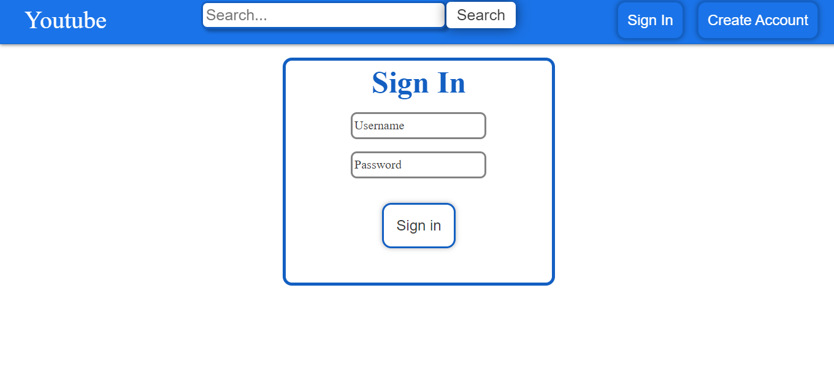
SignIn page

Slide 12
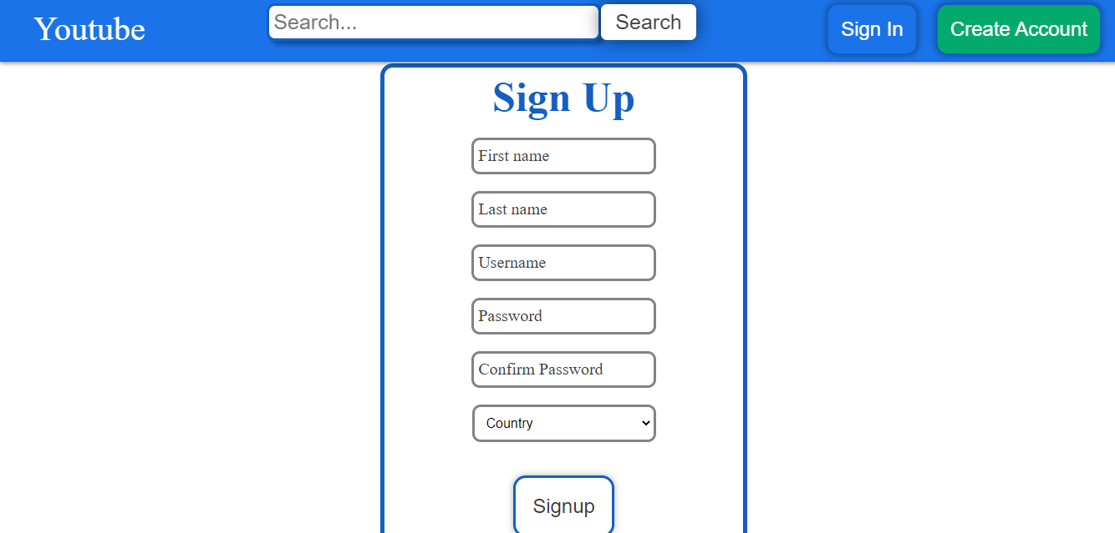
SignUp page

Slide 13
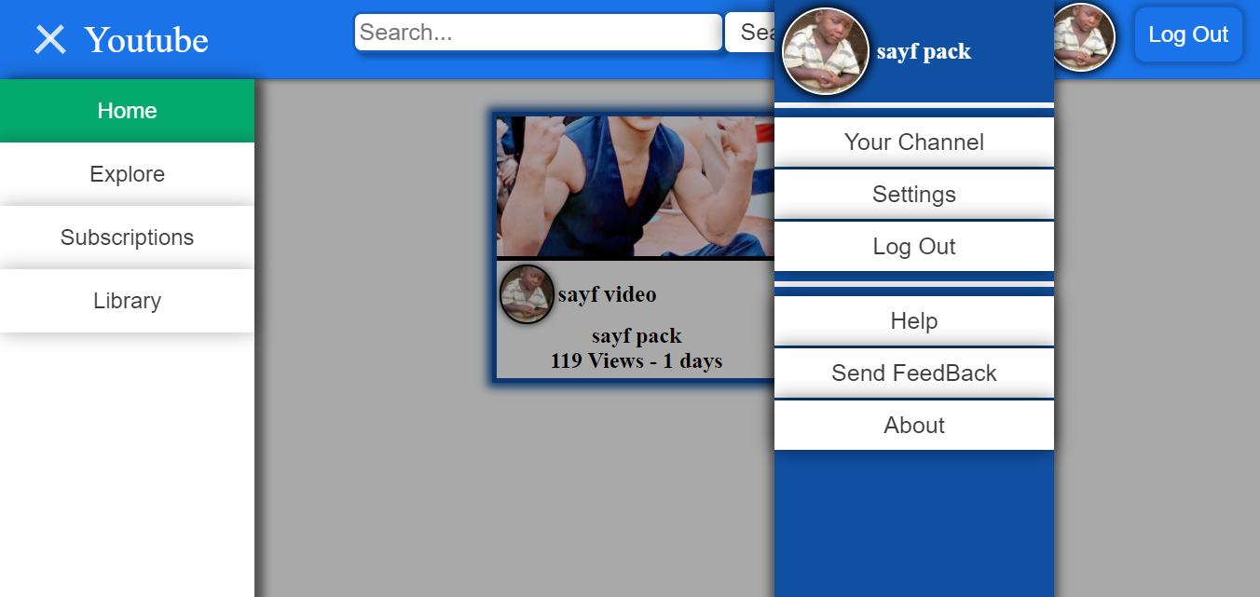
Home page (logged in)

Slide 14
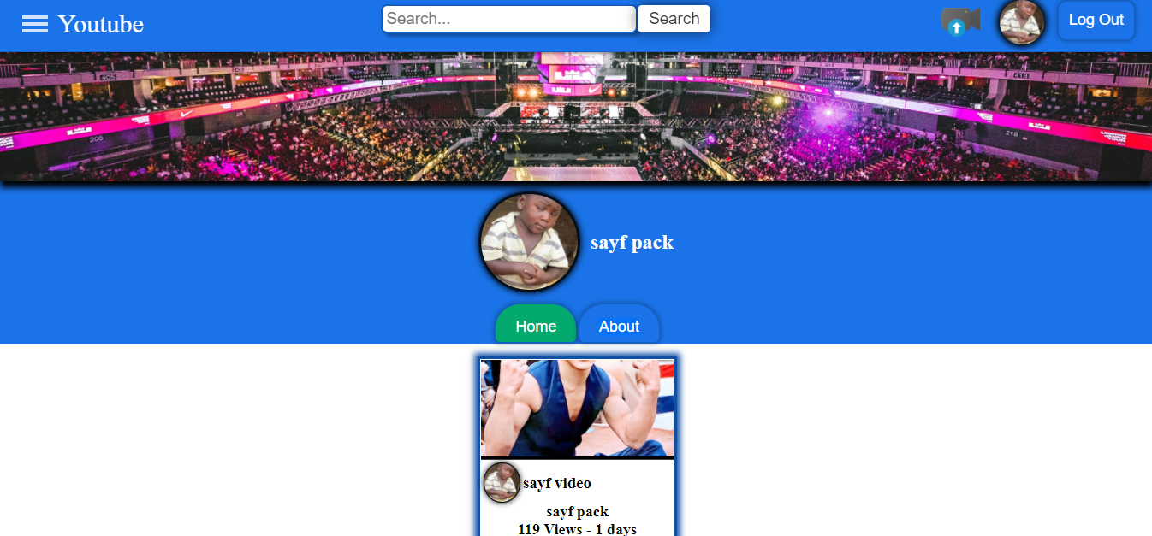
Channel page (logged in)

Slide 15
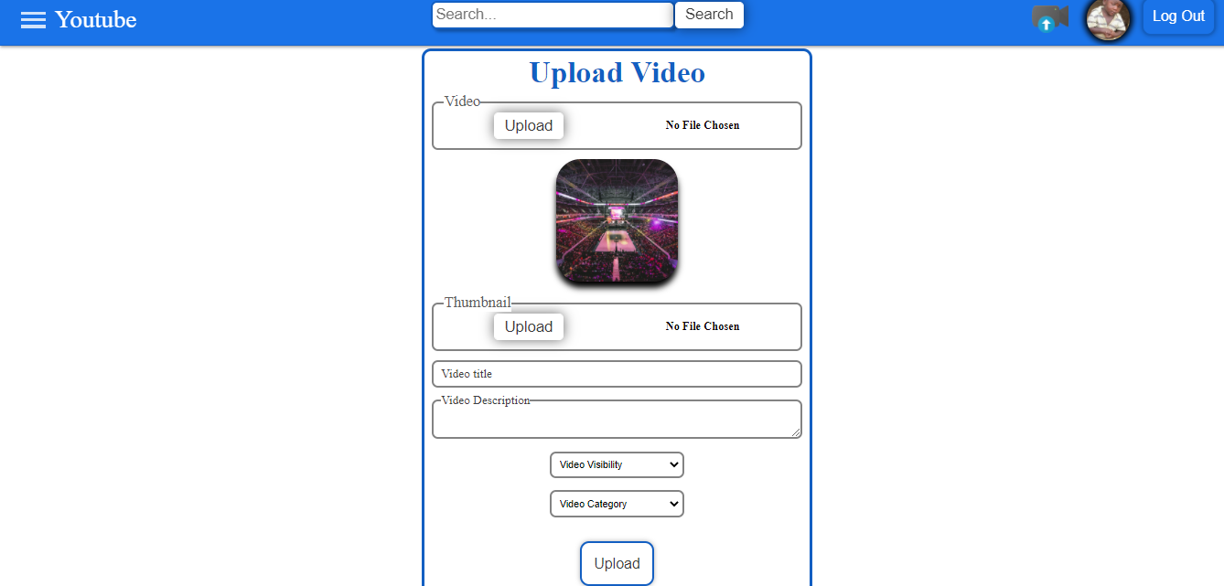
Uploading a video(logged in)

Slide 16
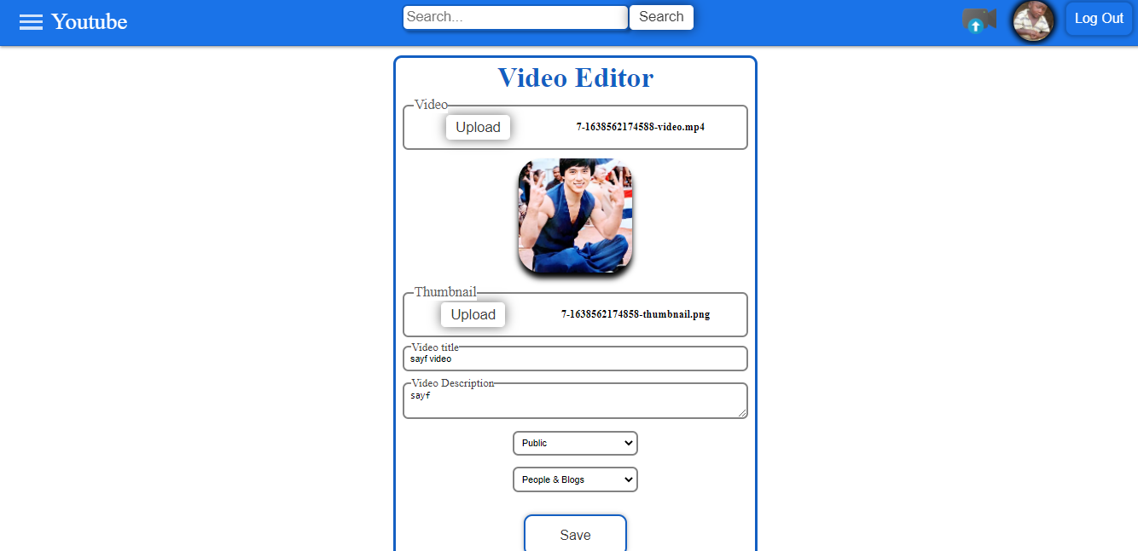
Editing a video(logged in)

Slide 17
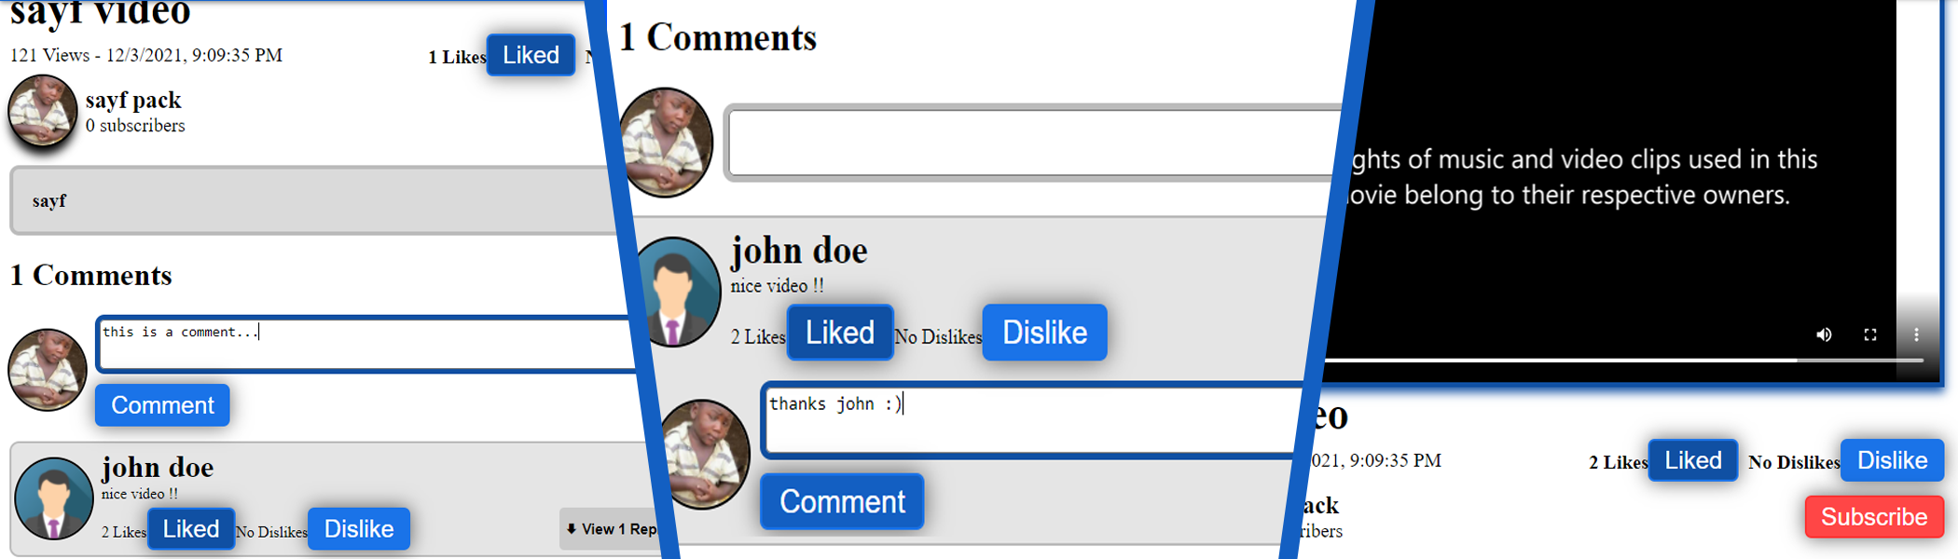
And more…
Commenting
Replying
Subscribing

Slide 18

04
USED TECHNOLOGIES

Slide 19




REACT
MYSQL
HTML CSS JS
Express

Slide 20

05
FEATURES

Slide 21
This application includes the major features of YouTube such as:
Home page with a list of videos
Watching videos
Searching for videos
Searching for users
Chatting with users
Sharing opinions/experience with others
Subscribing to channels
looks almost exactly like the original YouTube application ☺

Slide 22

THANK YOU FOR YOUR ATTENTION
Developed by Sayf Rourou

Slide 23

Cloning
Project

